Slide 1
The Secure Software Supply Chain (S3C) Function
By Aleksandar Andonov

Slide 2
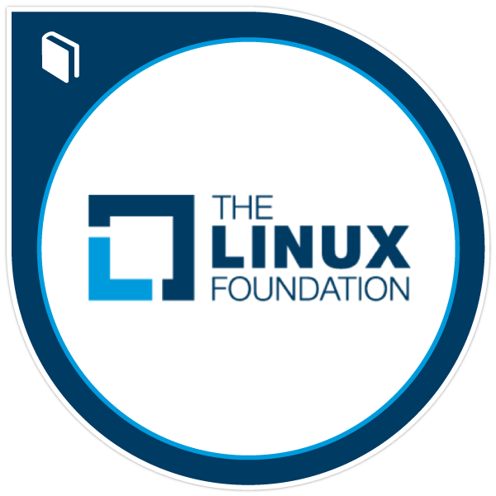
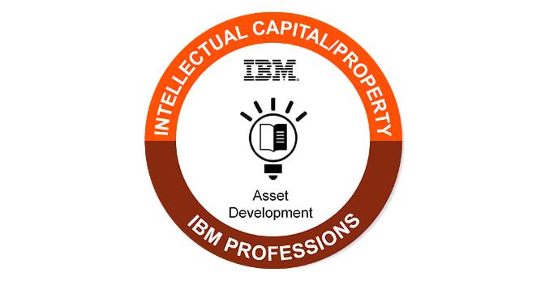
$ whoami
Exeprience in a startup, at Red Cross, emergency directorate, large corporations.
Support Engineer => Consultant => DevSecOps
Languages: bash, Python, Go

Slide 3
Topics
Context
What is an application?
Why use the supply chain as an attack vector?
How are applications built?
Demand input
Research and Development
Supply output
Takeaways
Q&A

Slide 4
Context

Slide 5
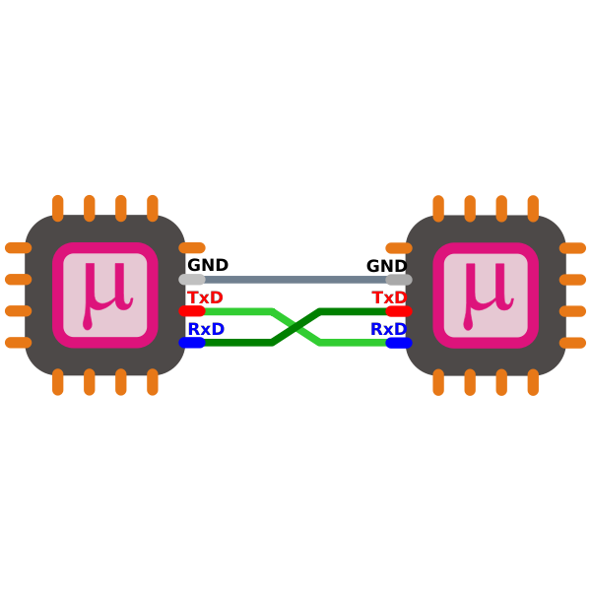

What is an application – product or service?
Transactional:
Once
Pay as you use (X as a service)
Subscription
PROVIDED “AS IS”, WITHOUT WARRANTY OF ANY KIND
Notes:
Short survey: Product? Service? Both?
Does an application exist without users? No. So if we look at it from a human point of view, an application is an agreement.
Yes, even if I use free/open source software and I never bothered to read the license terms I agreed to a contract. [show the MIT license line] We’re going to examine open source software later.
Let’s continue with commercial software.
Align security to the business!

Slide 6


Application Security
Notes:
Application security professionals need to protect both the company they are part of (which produces the product) as well as the customers of the product/service.

Slide 7

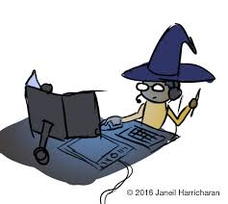

How are applications built?
Notes:
We might imagine a technical genius wizard who created their custom operating system, designed their own programming language and writes a complicated application. It’s a myth.
The thing about us people is that we don’t scale – to produce more we need to work together.
And remember that we’re working for a business which cannot operate long without profit. Consequently, there is some tight schedules to provide a product/service.
As a result, everyone is using standard libraries. There are other reasons besides economy of course – security, reliability etc.
What is central to development is people – there is ChatGPT which can write some code, but it’s not reliable. People continue to write the logic and machines fail to understand when the business logic of an application is bad.
Therefore, as security professionals we need to work with developers.
Manufacturing image from CNCF paper
This has important implications about the origin of the source code (so called provenance) which we’re going to discuss later

Slide 8
Why use the supply as an attack vector?
* Phase 1 - The Zero Day "... a collective race to patch before the bad actors can find and exploit your software." "A year after Log4Shell, many organizations ... remain entirely unaware and continue downloading a known vulnerability into their codebase."
Supplier
Consumer
Consumer
Consumer
* Phase 3 - The Corporate Developer "attacks on development infrastructure... dependency confusion saw an explosion of 430% [in 2020]... [in 2021 there was] another 650%"
* Phase 2 - The Software Supply Chain "if you can find a way to do something with one of the most popular packages ..., you can impact millions“
Notes:
Because there you reach a lot of victims at once and by abusing a trusted interface (== application) you can go unnoticed for a very long time. The SolarWinds breach was a historic moment that was a wake up call for a lot of people.
You might think – why should I care about this? SolarWind was hacked by a government military / intelligence agency.
Recent developments have demonstrated that less sophisticated methods can be used to achieve the same thing – for example the Lapsus hacker group. There is also typosquatting,etc.
Quotes from Sonatype state of OSS sec report

Slide 9

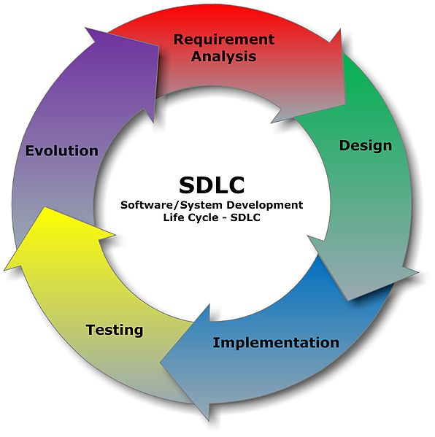

How can we protect the applications?
Build pipeline centric, technology focus
DevOps centric, technology focus
Management centric, process focus
Notes:
DevOps centric (loop) OR product management centric (lifecycle)
Lifecycle image from File:SDLC - Software Development Life Cycle.jpg - Wikimedia Commons
Based on Application Lifecycle Management which is used to accomplish sales goals, align with market trends, etc.

Slide 10
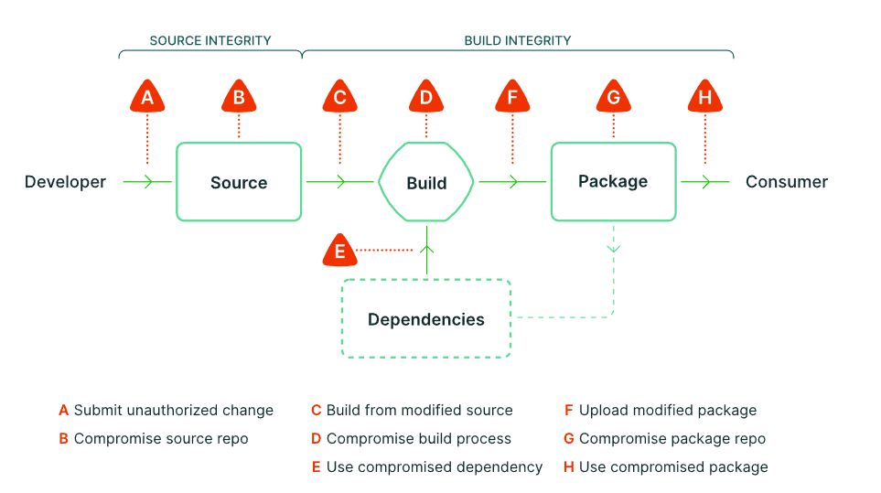
Supply Chain Levels for Software Artifacts
Notes:
SLSA • Supply-chain Levels for Software Artifacts
This creates a wrong mental model – if you’re waiting for step E to consider the dependencies, you are potentially going to need to rework a lot of the code.
Developing applications on Kubernetes - Inner Loop vs Outer Loop – Failing with Kubernetes (jorgemoral.es)

Slide 11
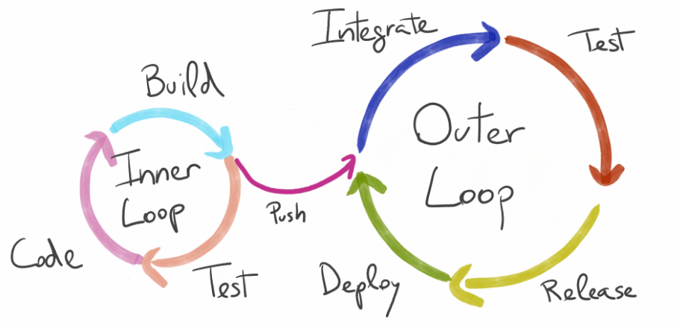
Developer workflow
Notes:
You spend time writing code relying on a new library. After that you push the library to the source code repository which triggers a build. You get notified that the build failed because the new dependency contains a known vulnerability.
You need to use another version of the dependency. However, this newer version has different function/method names and/or breaking changes. Now you have to rewrite the code.

Slide 12
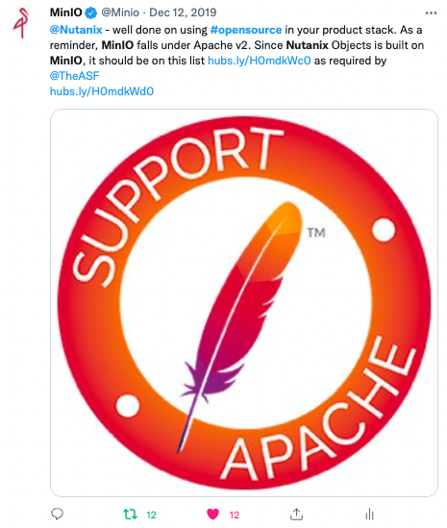
License violations -> revocation
Notes:
Update: Nutanix Objects Violates MinIO’s Open Source License

Slide 13
S3C Function

Slide 14
The Secure Software Supply Chain Function
Input
RnD()
Output
Assured delivery
Provenance validation
Secure design
Threat model
Dependency management
Code Review
Dynamic analysis
Operational security
Vulnerability Disclosure Program
Private registry
Incident response
Secure configuration by default
Runtime self- protection
Customer/Product Manager requirements
Acquisition criteria
Reference architecture
Notes:
Secure design vs Threat model – what is the difference?
Operational security (Container, Cluster, Cloud from the 4C) – hardened workstations, hardened infra – TLS, IAM, secrets not present in the repo
Code Review (Code from the 4C) – SAST (auto), manual [I avoid static analysis because it can be confusing when compared with composition analysis]
Dynamic analysis – DAST (auto), pen testing
IDE plugin is not the first line of defense! Runtime is the last line of defense
!! Use the ENISA review of such incidents compared to this model – BUT most incidents’ attack vector is unknown

Slide 15
Demand Input

Slide 16
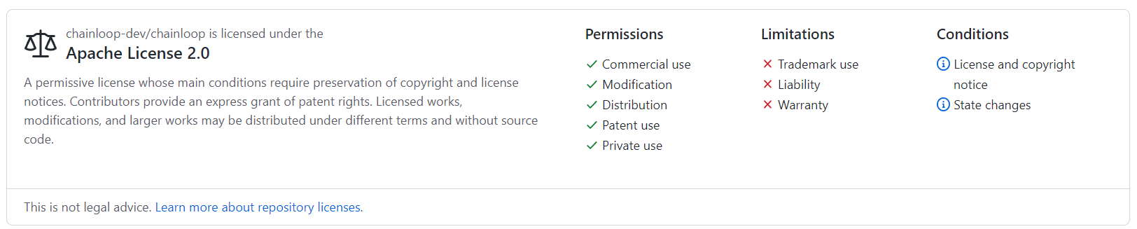
Licenses
Permissive – Restrictive (copyleft) – Commercial/Proprietary
An increasingly common business model is dual-licensing
Docker is Updating and Extending Our Product Subscriptions | Docker
Docker Desktop is paid, the Docker engine is free
Notes:
Image source chainloop/LICENSE.md at main · chainloop-dev/chainloop (github.com)

Slide 17
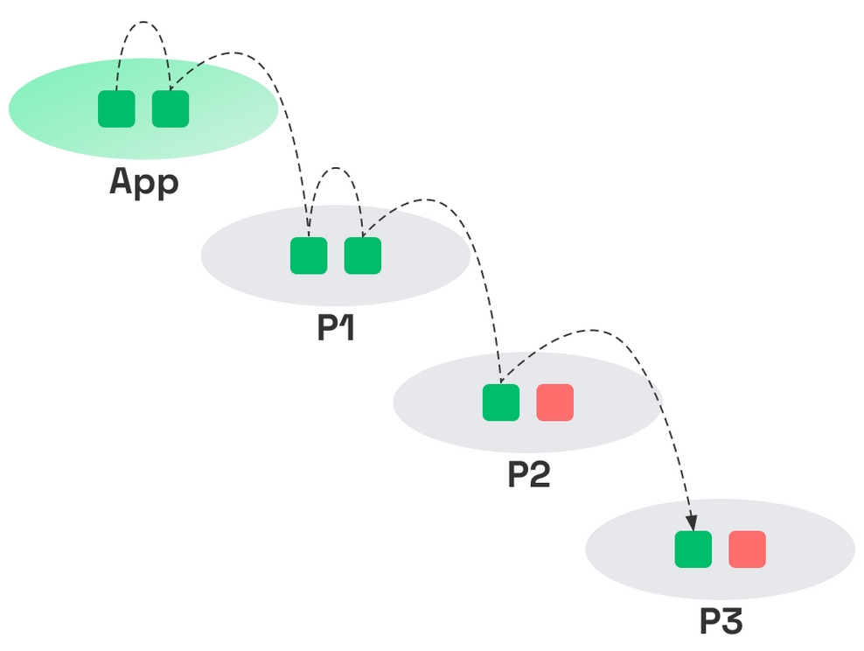
Why integrity is not enough?
The code that was implicated to cause Log4Shell in JndiManager.class was borrowed by 783 other projects, being seen in over 19,562 individual components.
Source: Sonatype
Notes:
Image from State of Dependency Management Report (endorlabs.com)
Conclusion => Prefer libraries with smaller dependency trees.
Make sure you disable any functionality you don’t use. With log4shell a lot of people would have had an easier time if they just disabled the functionality instead of patching.

Slide 18

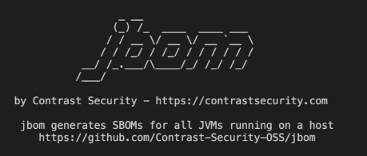
Software Bill of Materials
Static source -> Binary source -> Runtime
Notes:
Image source: GitHub]

Slide 19
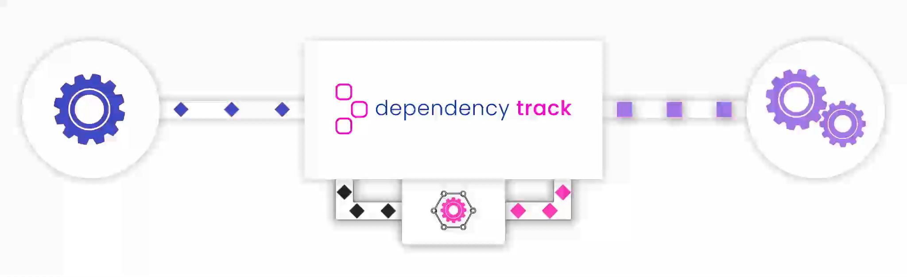
Dependency Track open source!
Central SBOM repository
Continuous feeds for vulnerabilities
Does NOT export reports out of the box.
Can NOT filter based on vulnerabilities in the UI.
Notes:
should include the design, the life cycle phase, the formulation

Slide 20

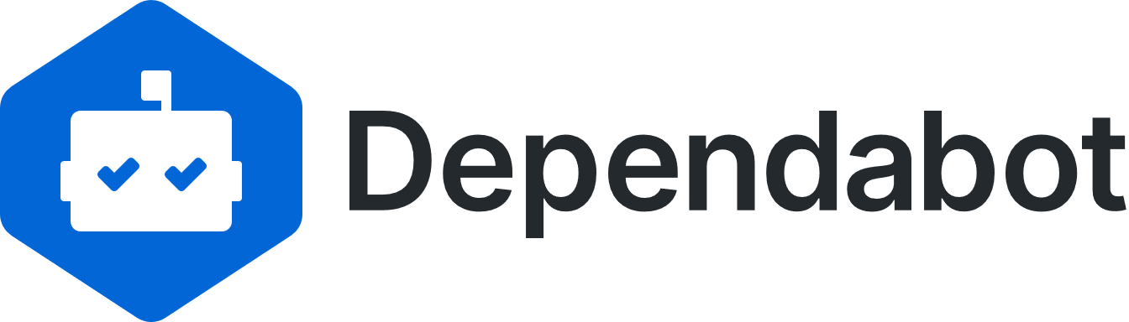
Mean Time to Update
[Observe] Create/check the inventory
[Orient] Scan to find known vulnerabilities
[Decide] Aggregate and prioritise those known vulnerabilities
[Act] Remediate the prioritised vulnerabilities
xApplications xDependencies xUpdates = TOO DAMN MUCH!
Notes:
Look for projects that are quick to update when new versions of their dependencies are released. If you see dependabot on GitHub it’s a good sign.
Renovate source: 68747470733a2f2f6170702e72656e6f76617465626f742e636f6d2f696d616765732f72656e6f766174655f3636305f3232302e6a7067 (660×220) (camo.githubusercontent.com)

Slide 21
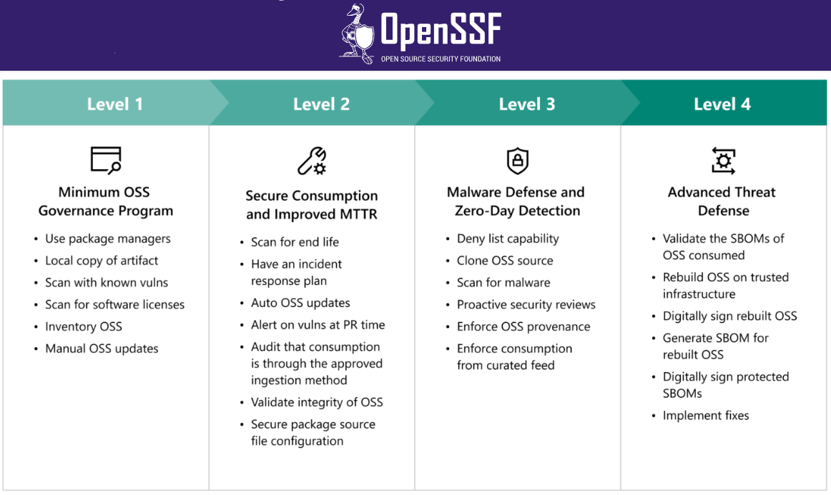
Consumption Framework
Notes:
Originally by Microsoft
(B2B) relationship management database - known points of contact on both sides, information sharing channels. This is also one of the inspirations for the vulnerability exploitability exchange (VEX) I believe.

Slide 22
OpenSSF Scorecard
$ curl 'https://api.securityscorecards.dev/projects/github.com/openssf/scorecard' -H 'accept: application/json' -o scorecard.json
% Total % Received % Xferd Average Speed Time Time Time Current
Dload Upload Total Spent Left Speed
0 0 0 0 0 0 0 0 --:--:-- 0:00:01 --:--:-- 0
$ jq '.checks[].name' scorecard.json
"Maintained"
"Code-Review"
"CII-Best-Practices"
"Vulnerabilities"
"Signed-Releases"
"License"
"Dangerous-Workflow"
"Packaging"
"Token-Permissions"
"SAST"
"Pinned-Dependencies"
"Dependency-Update-Tool"
"Binary-Artifacts"
"Security-Policy"
"Branch-Protection"
"Fuzzing"
Notes:
You are both evaluating and being evaluated on these criteria! You can see how the chain works.

Slide 23
function Research_Development()

Slide 24
Risk assessment
Risk handling
selector
Fix
Mitigate
selector
Accept
Transfer
Notes:
OWASP Threat Dragon is a great tool. The newer version 2 has a larger canvas and they are working on making it compatible with Draw.io diagrams
By carefully implementing the architecture it is possible to avoid whole classes of vulnerabilities
But this is just the theory – we should also monitor how the implementation is actually done. Are there differences between the design and the implementation – why?

Slide 25


Inventory – reproducible builds
Timestamps
Image digest
Notes:
Image sources from the relevant GitHub repositories

Slide 26
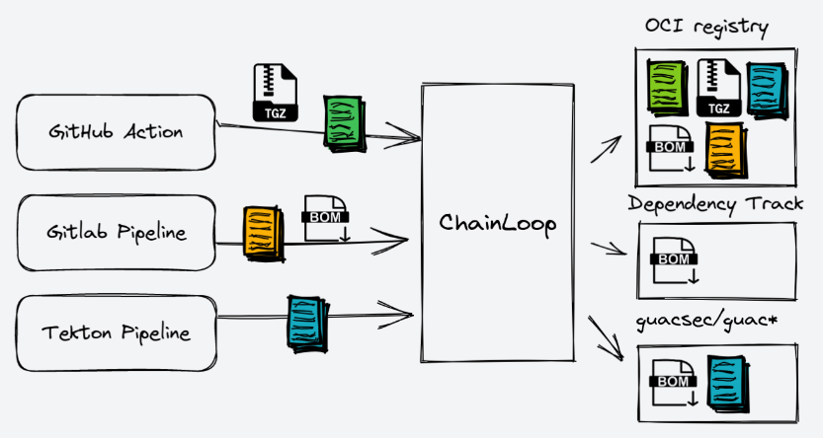
Chainloop

Slide 27
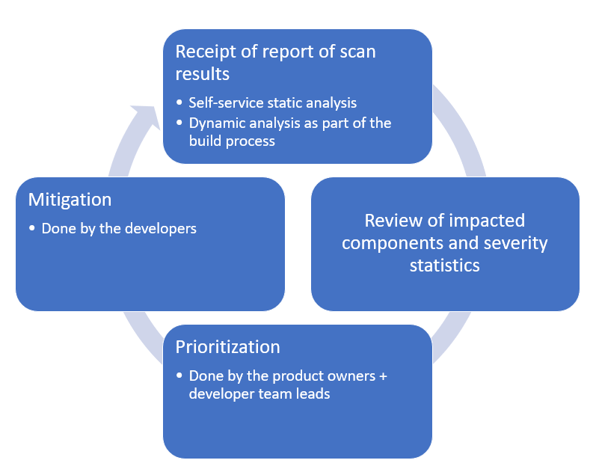
Feedback loops
Notes:
Secure software requires more than just tools. You need to align your people, processes, and technology to address security risks based on your organization’s unique policies and business objectives.
Prioritization here is about vulnerabilities in our first party source code.

Slide 28
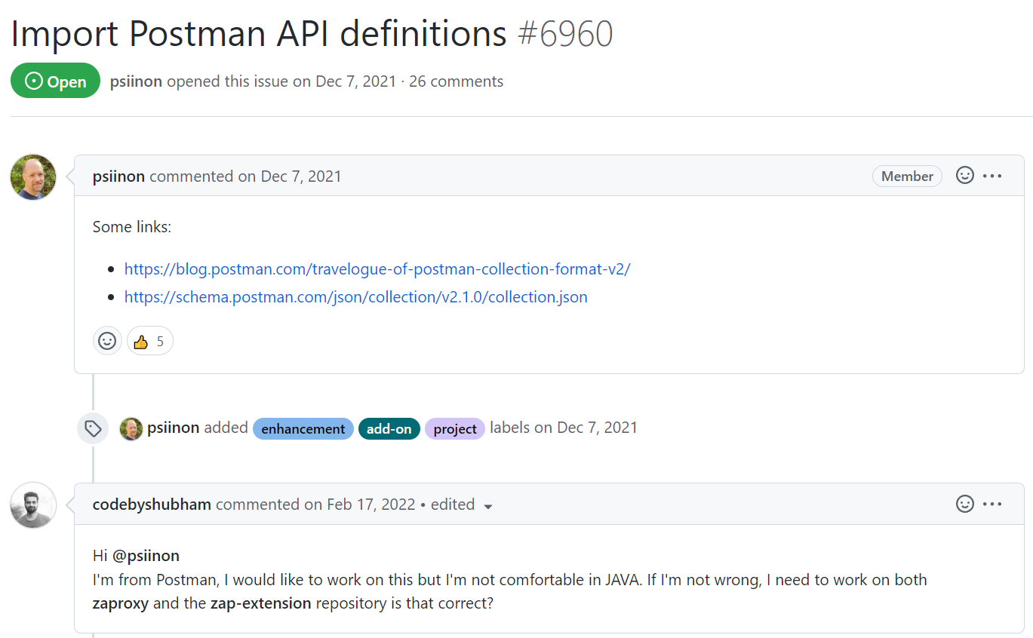
Quality and Security Assurance
Notes:
Import Postman API definitions · Issue #6960 · zaproxy/zaproxy (github.com)
Configuring Postman to use the OWASP Zed Attack Proxy. I’m not suggesting that

Slide 29
Supply output

Slide 30
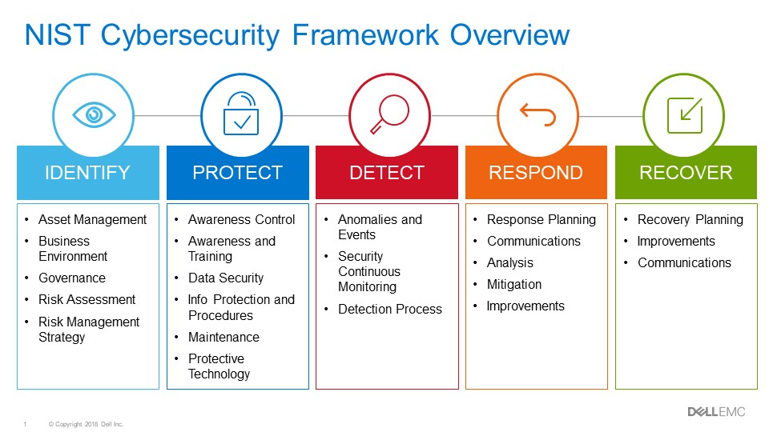
if I scan my images for vulnerabilities, misconfigurations and compliance violations early in the CI/CD pipeline, I have successfully prevented threats in my container and Kubernetes environments
Notes:
Image source: Strengthen Security of Your Data Center with the NIST Cybersecurity Framework | Dell USA

Slide 31
Operational Security
Compute/Cloud | Identity
 | Network
 | Runtime
 | Storage
Cluster | Identity
 | Network
 | Runtime
 | Storage
Container | Identity
 | Network
 | Runtime
 | Storage
Code | Identity
 | Network
 | Runtime
 | Storage
Notes:
Example with storage:
The code stores data in memory addresses and possibly even uses an in-memory database (sqllite)
The container has environmental variables and volume mounts
The cluster has configmaps and secrets + volume claims
The compute has env variables, databases and hard drives
All of those need to be secured!

Slide 32
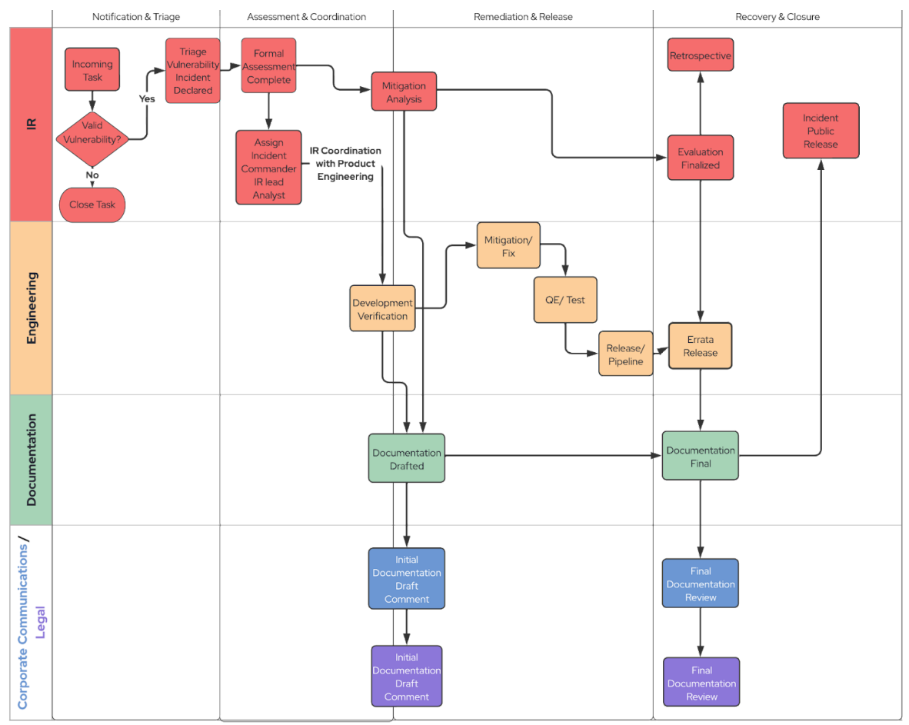
Incident Response
Notes:
RedHat donated their process to FIRST

Slide 33
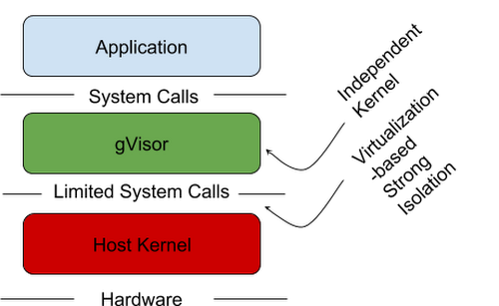
Tools
ID/PS
WAF
RASP
Notes:
Will perimeter firewalls give way to ‘RASP’? | Network World Joseph Feiman argued ardently that RASP, https://www.contrastsecurity.com/glossary/rasp-security Coined by Gartner in 2012
Image source: gvisor-sandbox-containerst5kz.max-500x500.PNG (500×307) (storage.googleapis.com)

Slide 34
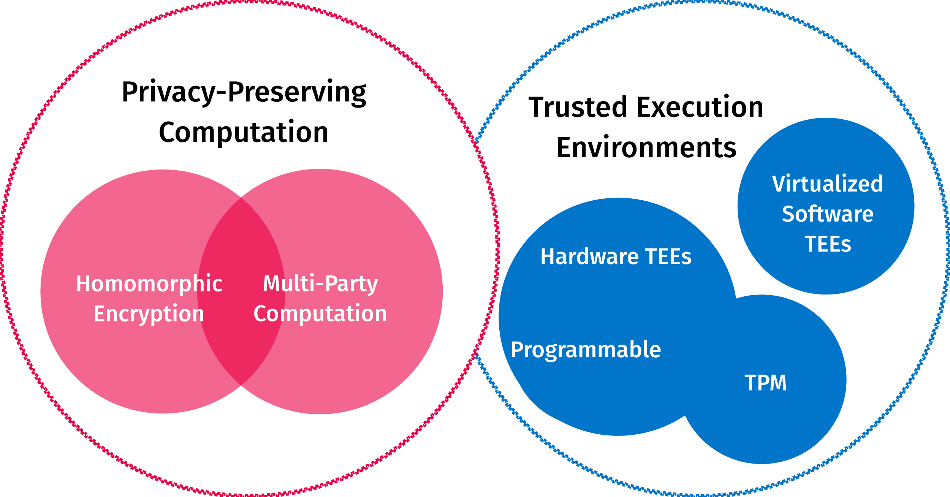
The future – confidential computing
Notes:
Everest Group - Confidential Computing – The Next Frontier in Data Security
Department of Computer Science and Technology: Capability Hardware Enhanced RISC Instructions (CHERI) (cam.ac.uk)
Image source: https://confidentialcomputing.io/wp-content/uploads/sites/10/2022/07/double_circle.svg

Slide 35
Takeaways
Input
RnD()
Output
Assured delivery
Provenance validation
Secure design
Threat model
Dependency management
Code Review
Dynamic analysis
Operational security
Vulnerability Disclosure Program
Private registry
Incident response
Secure configuration by default
Runtime self- protection
Customer/Product Manager requirements
Acquisition criteria
Reference architecture
Notes:
# Input
For developers
Verify the licenses first and make every effort to honor them
Prefer libraries with smaller dependency trees.
Use a bot to assist you with dependency updates.
For security practitioners
Demand SBOMs from external vendors and examine them.
Inventorise the software you protect.
Continuously monitor the vulnerabilities feeds.
# RnD
For developers
Follow secure practices and don’t try to invent custom algorithms for authentication/authorization
Be sure to remove any logic you put for testing or debugging
For security practitioners
Build feedback loops for the developers
Prefer implementing guardrails instead of gates
Collaborate with QA to perform testing
# output
For security practitioners
Have an incident response plan
Practice!

Slide 36
Q & A
aleksv.andonov@protonmail.com

